Slide 1
SS ZG622:
Software Project Management
(Resource/Cost Scheduling)
Prof K G Krishna, BITS-Pilani Off-campus centre, Hyderabad

Slide 2


Text Books
T1: Pressman, R.S. Software Engineering : A Practitioner’s Approach, 7th Edition, TMH, 2010
T2: Hughes, B and Cotterel, M., Software Project Management, 11th Edition, TMH, 2011
S1: Frank Tsui, Managing Software Projects, Jones&Bartlett, 2011
S2: Pankaj Jalote, Software Project Management in Practice, Pearson Education, 2002
Note: In order to broaden understanding of concepts as applied to Indian IT industry, students are advised to refer books of their choice and case-studies in their own organizations

Slide 3
Resource Allocation/Loading
Cost Scheduling
Source Courtesy: Some of the contents of this PPT are sourced from materials provided by Publishers of T1 & T2

Slide 4
Schedules in general…
Activity schedule - indicating start and completion dates for each activity
Resource schedule - indicating dates when resources needed + level of resources
Cost schedule showing accumulative expenditure
Notes:
Section 8.1 paged 193. We have already described the creation of the activity schedule in Lecture/activity 6.

Slide 5
Resources
These include
  labour
  equipment (e.g. workstations)
  materials
  space
  services
Time: elapsed time can often be reduced by adding more staff
Money: used to buy the other resources
SPM (5e) resource allocation© The McGraw-Hill Companies, 2009
Notes:
Section 8.2 in the main text discusses this in a little more detail.
A key point is that money (by definition) is the means by which one resource can be converted to another. However in practice this may be problematic because of resource constraints e.g. staff need time to become expert in a new technology regardless of the amount of money that might be available to buy expertise.

Slide 6
Resource allocation
Identify the resources needed for each activity and create a resource requirement list
Identify resource types - individuals are interchangeable within the group (e.g. ‘VB programmers’ as opposed to ‘software developers’)
Allocate resource types to activities and examine the resource histogram
SPM (5e) resource allocation© The McGraw-Hill Companies, 2009
Notes:
This is covered in Section 8.3 of the text.
Note that at this point we have to assume that we are dealing with, for example, ‘standard’ software developers who have an average productivity. When we allocate actual people we may find that we have a trainee or a super-expert and this will affect productivity. A short-coming in productivity in an individual might be compensated for by a lower cost (as would be expected with trainees).
In the example in the text we start by scheduling every activity to start at the earliest possible date. However in Lecture/Chapter 7, in the section on the critical chain technique it was suggested that we plan to start activities as late as possible. Whatever the starting procedure, we then need to deal with resource clashes.

Slide 7
Resource histogram:
5
4
STAFF REQD.
3
2
1
WEEK
1
2
3
4
5
6
7
SPM (5e) resource allocation© The McGraw-Hill Companies, 2009
Notes:
The resource histogram helps us identify where the demand for a resource exceeds the supply.
If we use a tool such as MS Project, the tool will generate the resource histograms for us.

Slide 8
Resource smoothing
It is usually difficult to get specialist staff who will work odd days to fill in gaps – need for staff to learn about application etc.
Staff often have to be employed for a continuous block of time
Desirable to employ a constant number of staff on a project – who as far as possible are fully employed
SPM (5e) resource allocation© The McGraw-Hill Companies, 2009

Slide 9
Resource smoothing
5
4
STAFF REQD.
3
2
1
WEEK
1
2
3
4
5
6
7
8
SPM (5e) resource allocation© The McGraw-Hill Companies, 2009
Notes:
This shows an attempt to smooth the previous resource histogram. Note that in order to do this, we have had to
Add another week to the schedule.
Exercise 8.1 in the text gives some practice in resource smoothing.

Slide 10
Resource clashes
Where same resource needed in more than one place at the same time
can be resolved by:
  delaying one of the activities
    taking advantage of float to change start date
    delaying start of one activity until finish of the other activity that resource is being used on - puts back project completion
  moving resource from a non-critical activity
  bringing in additional resource - increases cost
SPM (5e) resource allocation© The McGraw-Hill Companies, 2009

Slide 11
Prioritizing activities
There are two main ways of doing this:
Total float priority – those with the smallest float have the highest priority
Ordered list priority – this takes account of the duration of the activity as well as the float (contd..)
SPM (5e) resource allocation© The McGraw-Hill Companies, 2009
Notes:
Where more than one activity is competing for the same limited resource at the same time then those activities need to be prioritized.
Section 8.4 Page 201

Slide 12
Burman’s priority list
Give priority to:
Shortest critical activities
Other critical activities
Shortest non-critical activities
Non-critical activities with least float
Non-critical activities
SPM (5e) resource allocation© The McGraw-Hill Companies, 2009

Slide 13
Resource usage
need to maximise %usage of resources i.e. reduce idle periods between tasks
need to balance costs against early completion date
need to allow for contingency
SPM (5e) resource allocation© The McGraw-Hill Companies, 2009

Slide 14
Affecting Critical path?
Scheduling resources can create new dependencies between activities
It is best not to add dependencies to the activity network to reflect resource constraints
  Makes network very messy
  A resource constraint may disappear during the project, but link remains on network
Amend dates on schedule to reflect resource constraints
SPM (5e) resource allocation© The McGraw-Hill Companies, 2009
Notes:
In Lecture/chapter 7 the concept of critical chains was introduced which took account of resource constraints.
The point about not adding links to the network to deal with resource constraints is not in the text, but is based on practical experience. The notation for activity networks does not tell you why one activity might be dependent on the completion of another.

Slide 15
Allocating individuals to activities
The initial ‘resource types’ for a task have to be replaced by actual individuals.
Factors to be considered:
Availability
Criticality
Risk
Training
Team building – and motivation
Notes:
Availability – who is free? Note that this will change during the course of the project as some tasks are completed earlier or later than planned
Criticality – You would want to put your more experienced, ‘safer’, staff on the critical activities
Risk – this is similar to the point above, but some activities could be off the critical path but still have risks e.g. to the quality of subsequent products
Training – despite concerns about minimizing risk, it is healthy to take some risks in order to develop staff capabilities by allocating challenging tasks to relatively inexperienced stafff
Team-building – identifying people who work well together can pay dividends; chopping and changing plans all the time may in theory optimize project performance, but can in practice be demotivating for staff
Section 8.7 Page 203

Slide 16
Cost schedules
Cost schedules can now be produced:
Costs include:
Staff costs
Overheads
Usage charges
SPM (5e) resource allocation© The McGraw-Hill Companies, 2009
Notes:
Section 8.9 covers this in more depth.
Staff costs – includes not just salary, but also social security contributions by the employer, holiday pay etc. Timesheets are often used to record actual hours spent on each project by an individual. One issue can be how time when a staff member is allocated and available to the project, but is not actually working on the project, is dealt with.
Overheads e.g. space rental, service charges etc. Some overheads might be directly attributable to the project; in other cases a percentage of departmental overheads may be allocated to project costs.
Usage charges – some charges can be on a ‘pay as you go’ basis e.g. telephone charges, postage, car mileage – at the planning stage an estimate of these may have to be made

Slide 17
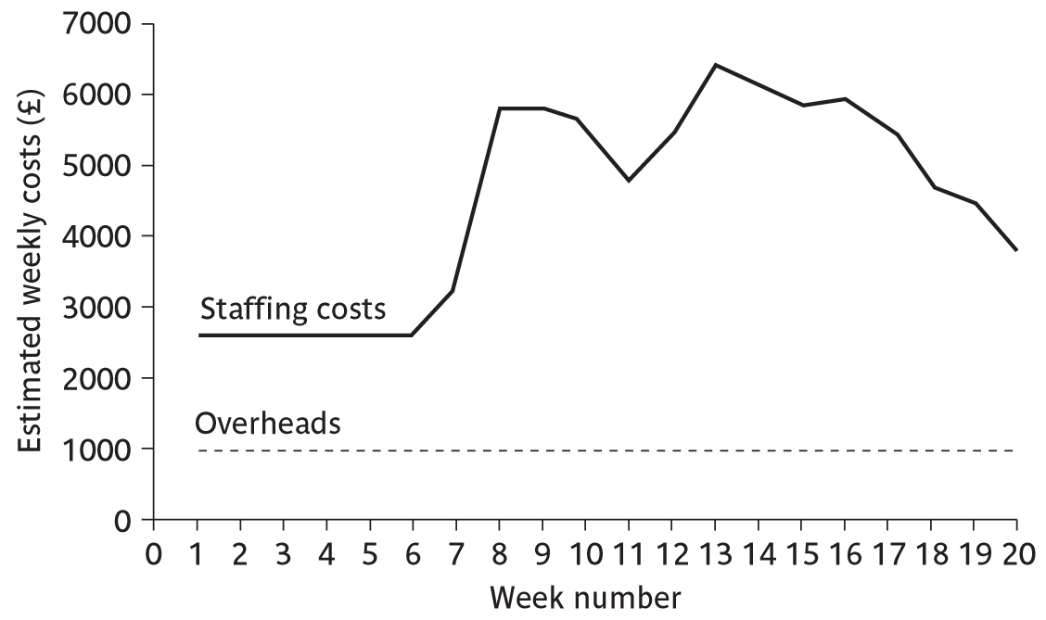
Cost profile
SPM (5e) resource allocation© The McGraw-Hill Companies, 2009
Notes:
This shows how much is going to be spent in each week. This could be important where an organization allocates project budgets by financial year or quarter and the project straddles more than one of these financial periods

Slide 18
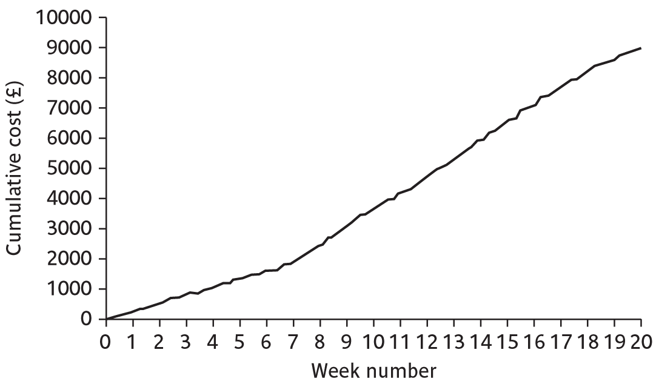
Accumulative costs
SPM (5e) resource allocation© The McGraw-Hill Companies, 2009
Notes:
The project manager will also be concerned about planned accumulative costs. This chart can be compared to the actual accumulative costs when controlling the project to assess whether the project is likely to meet its cost targets.

Slide 19
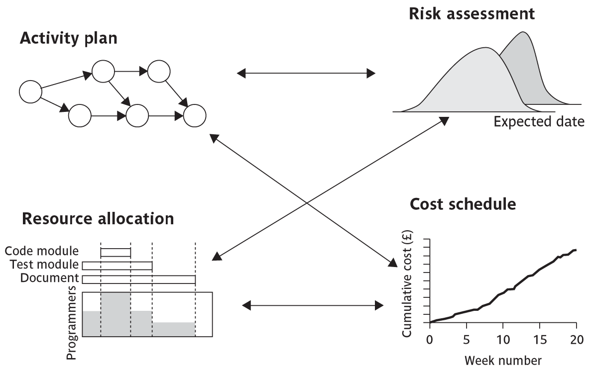
Balancing concerns
SPM (5e) resource allocation© The McGraw-Hill Companies, 2009
Notes:
Successful project scheduling is not a simple sequence.
Because of the inter-linking of different concerns project planning will need to be iterative. The consequences of decisions will need to carefully assessed and plans adjusted accordingly.

Slide 20
Please do some simple exercises given in the text-book
Thank You

